Slide 1
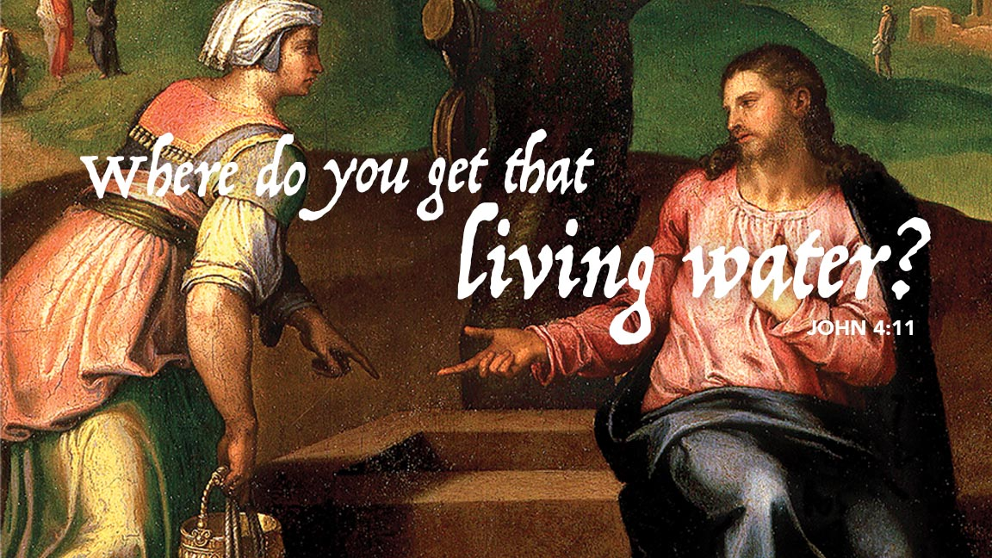
Notes:
Cover: Christ and the Samaritan Woman by Marcello Venusti. Copyright © The Art Archive/Superstock. Used by permission.

Slide 2

She Was Already Isolated
Notes:
Cover: Christ and the Samaritan Woman by Marcello Venusti. Copyright © The Art Archive/Superstock. Used by permission.

Slide 3
She Was Already Isolated
A
woman
Samaritan
Who had her issues with men,
Who came to the community well when others wouldn’t be there,
Yet risked a conversation with Jesus in the bright of day (unlike Nicodemus who came by night).
Notes:
Cover: Christ and the Samaritan Woman by Marcello Venusti. Copyright © The Art Archive/Superstock. Used by permission.

Slide 4
She Is Blessed With Reconnection
A Rabbi,
The Messiah,
The Great I AM,
Who knows her intimately,
Yet does not judge her,
But gives her the LIVING WATER of an abiding relationship with God
And community with others.
ἐγώ εἰμι
X
I am he
הָיָה
Notes:
Cover: Christ and the Samaritan Woman by Marcello Venusti. Copyright © The Art Archive/Superstock. Used by permission.

Slide 5
You Are Not Isolated, For Here Is…
The Rabbi,
The Messiah,
The Great I AM,
Who knows you intimately,
Yet does not judge you,
But gives you the LIVING WATER of an abiding relationship with God
And community with others.
ἐγώ εἰμι
X
I am he
הָיָה
Notes:
Cover: Christ and the Samaritan Woman by Marcello Venusti. Copyright © The Art Archive/Superstock. Used by permission.

Slide 6
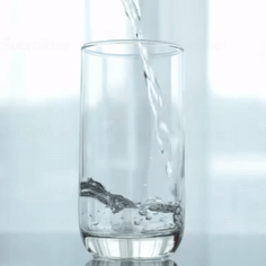
DRINK DEEPLY
Notes:
Cover: Christ and the Samaritan Woman by Marcello Venusti. Copyright © The Art Archive/Superstock. Used by permission.

Slide 7
Notes:
Cover: Christ and the Samaritan Woman by Marcello Venusti. Copyright © The Art Archive/Superstock. Used by permission.

