Slide 1
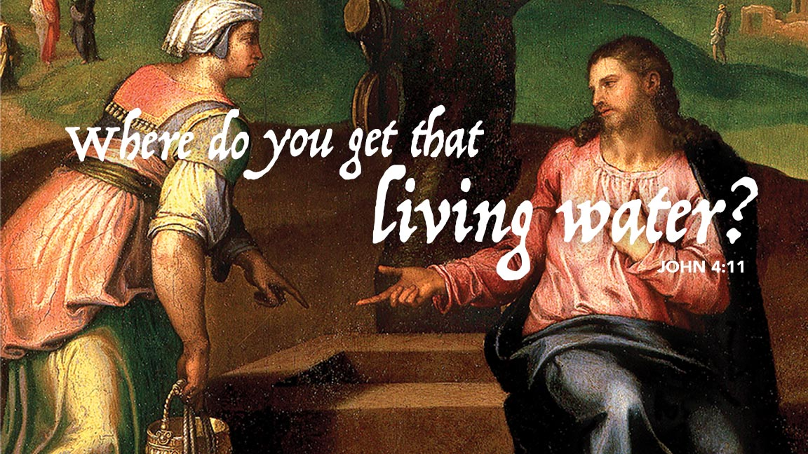
Notes:
Cover: Christ and the Samaritan Woman by Marcello Venusti. Copyright © The Art Archive/Superstock. Used by permission.

Slide 2
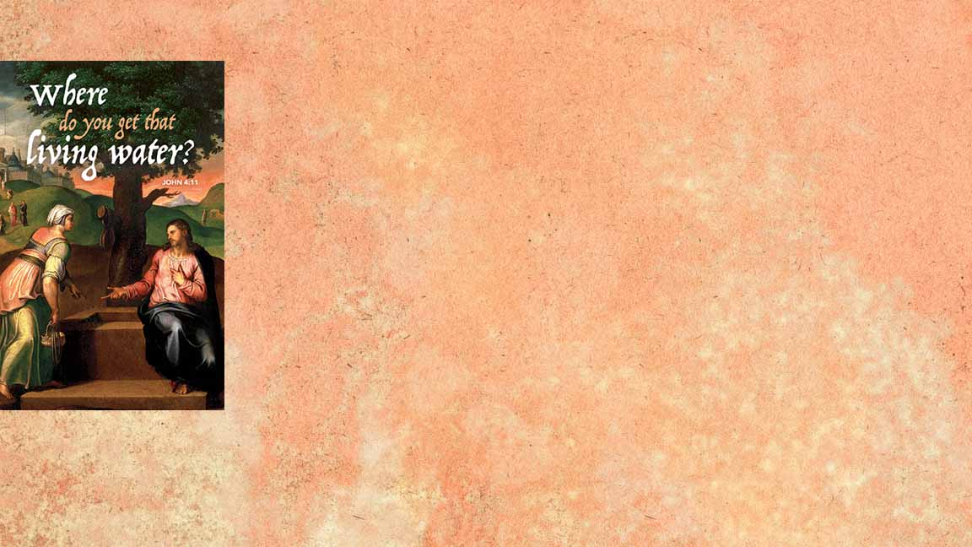
WELCOME TO WORSHIP!
Notes:
Cover: Christ and the Samaritan Woman by Marcello Venusti. Copyright © The Art Archive/Superstock. Used by permission.

Slide 3

Responding to the Pandemic at Immanuel
Corporate worship and various gatherings will continue unless specifically suspended.
As of now:
- NO Sunday School Classes until further notice
- NO Come to Supper tonight
- NO Confirmation Classes (resources moving online)
- MARKED! Event postponed indefinitely
Council will discuss further actions at its Tuesday meeting.
Notes:
Cover: Christ and the Samaritan Woman by Marcello Venusti. Copyright © The Art Archive/Superstock. Used by permission.

Slide 4
Things to Consider for Corporate Worship
If you’re sick or at greater risk, please don’t come.
Wash hands before/after. Please refrain from handshaking.
Offering plates will not be passed but placed at exits.
Pray for those most vulnerable, including our health care workers and their families.
Check by phone on those you notice aren’t here, especially those that live alone. Do you need help? You’re not alone.
Notes:
Cover: Christ and the Samaritan Woman by Marcello Venusti. Copyright © The Art Archive/Superstock. Used by permission.

Slide 5

Videos from our Thursday 6:00 pm Bible Study
will be posted at www.ImmanuelNegaunee.org
You’re always welcome to join the group.
A great topic, especially now!
Notes:
Cover: Christ and the Samaritan Woman by Marcello Venusti. Copyright © The Art Archive/Superstock. Used by permission.

Slide 6
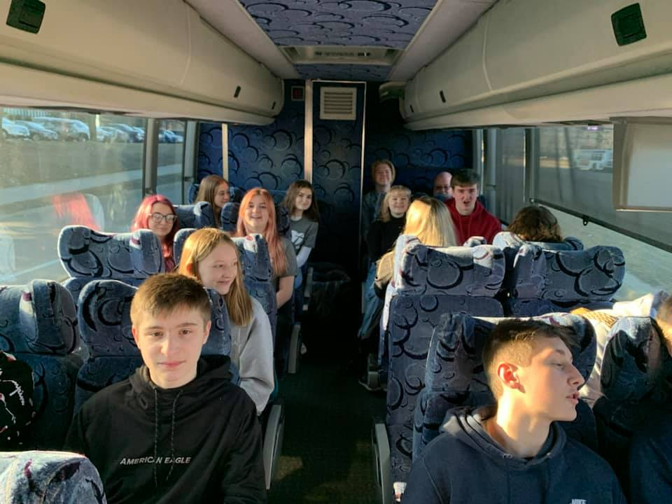
Our Youth made it safely to Minnesota and will return tonight.
Their first event was food packaging at Feed My Starving Children.
Notes:
Cover: Christ and the Samaritan Woman by Marcello Venusti. Copyright © The Art Archive/Superstock. Used by permission.

Slide 7

Notes:
Cover: Christ and the Samaritan Woman by Marcello Venusti. Copyright © The Art Archive/Superstock. Used by permission.

Slide 8
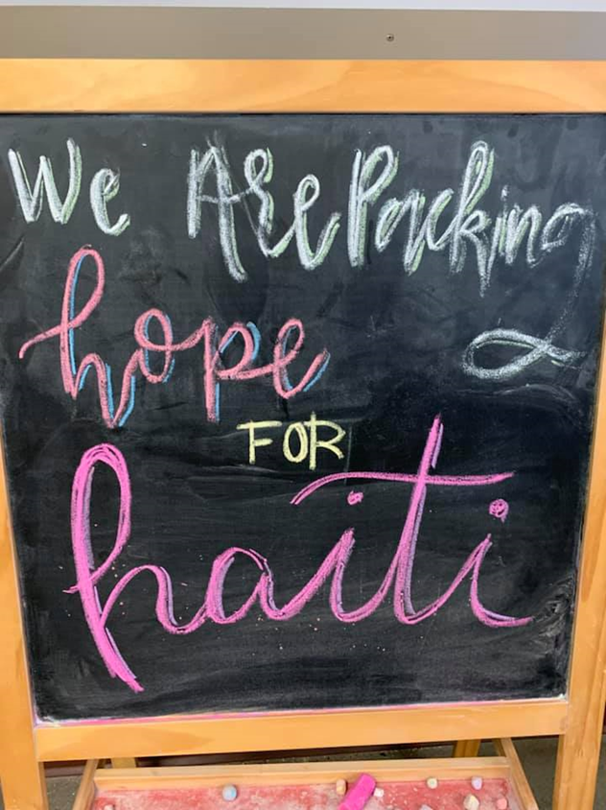
Notes:
Cover: Christ and the Samaritan Woman by Marcello Venusti. Copyright © The Art Archive/Superstock. Used by permission.

Slide 9
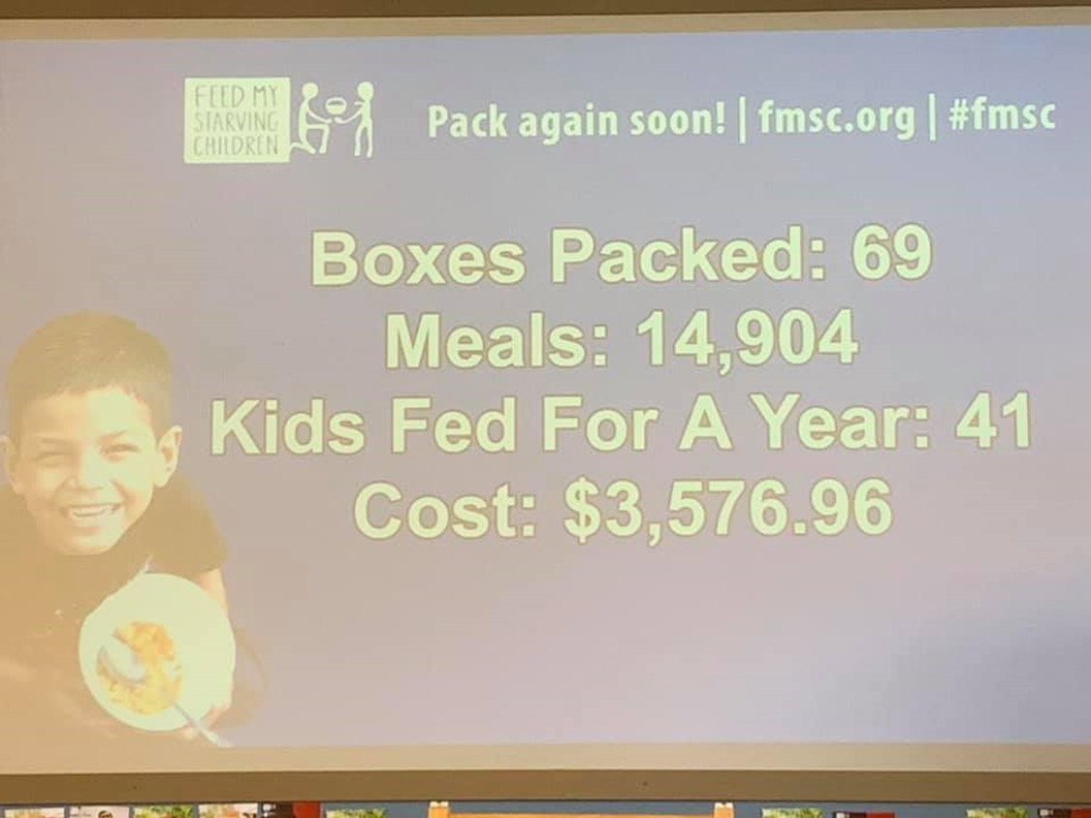
Notes:
Cover: Christ and the Samaritan Woman by Marcello Venusti. Copyright © The Art Archive/Superstock. Used by permission.

Slide 10
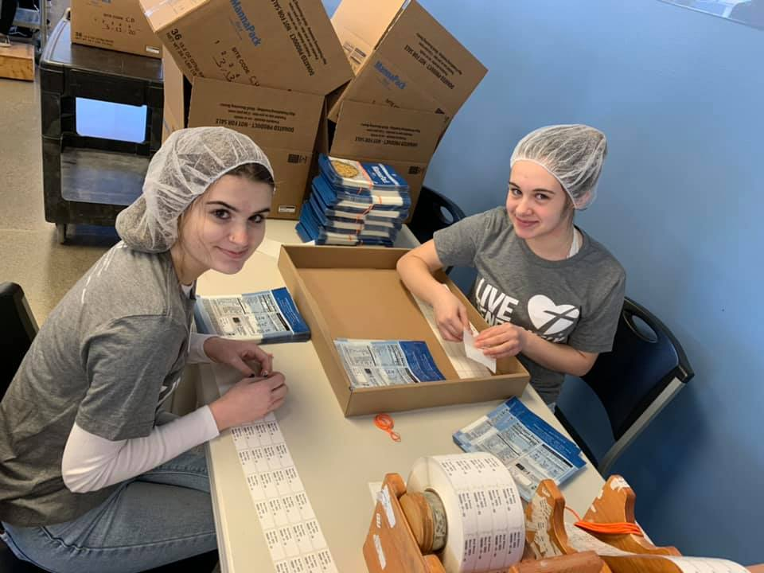
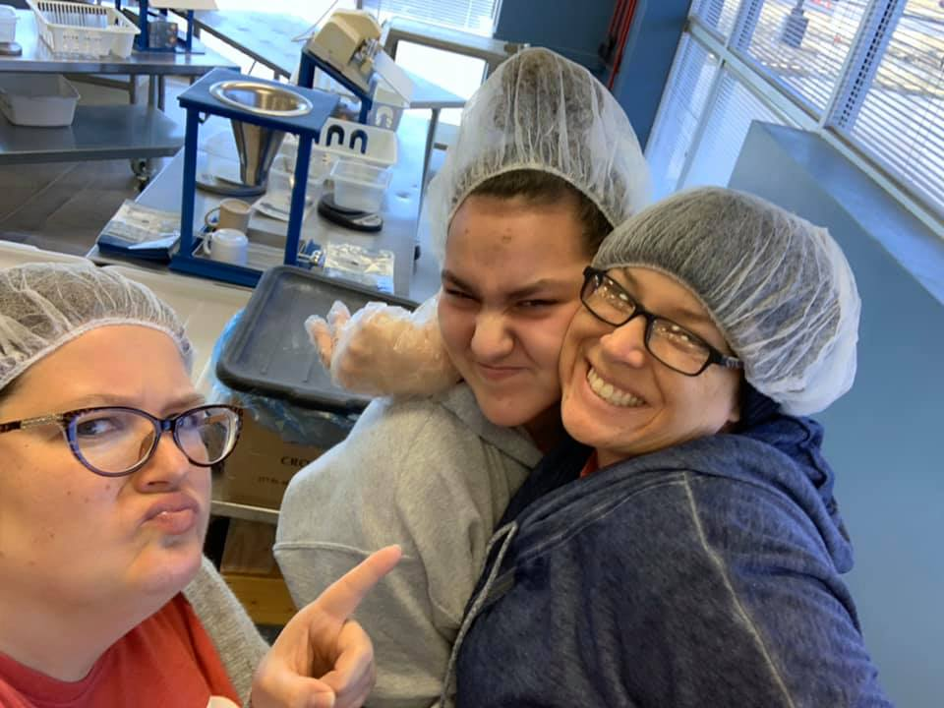
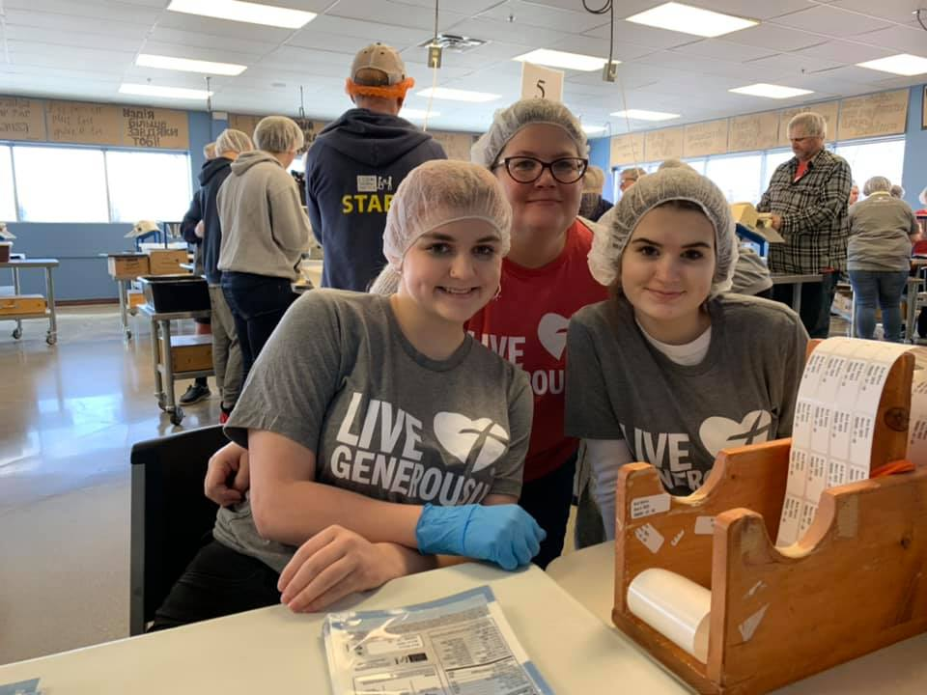
Notes:
Cover: Christ and the Samaritan Woman by Marcello Venusti. Copyright © The Art Archive/Superstock. Used by permission.

Slide 11
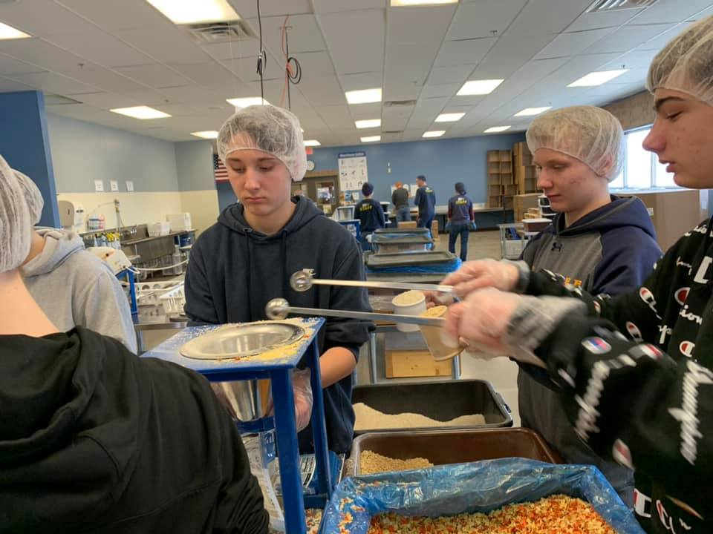
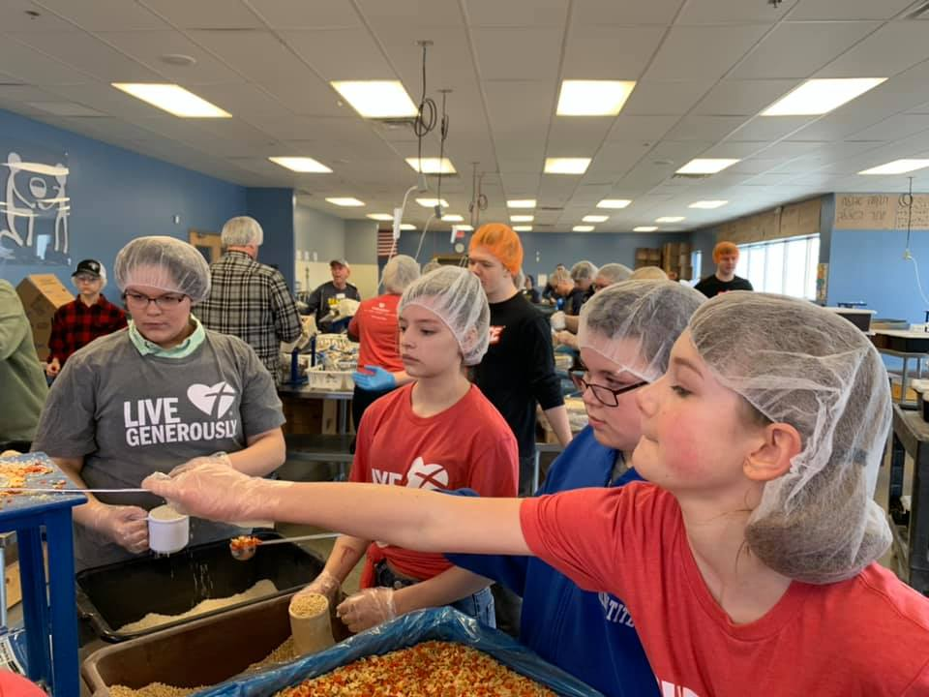
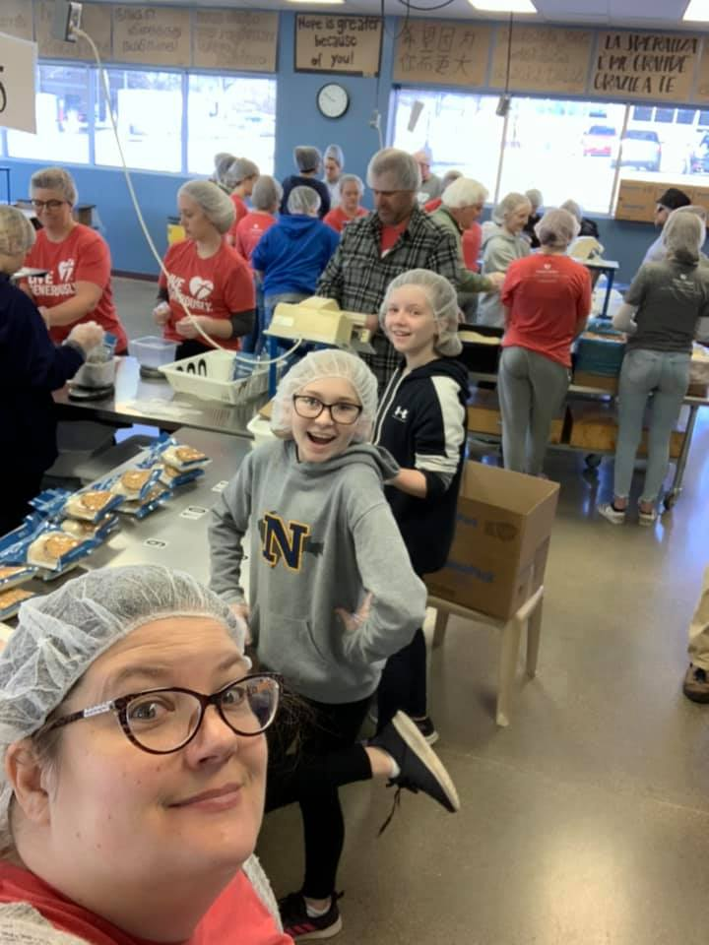
Notes:
Cover: Christ and the Samaritan Woman by Marcello Venusti. Copyright © The Art Archive/Superstock. Used by permission.

Slide 12
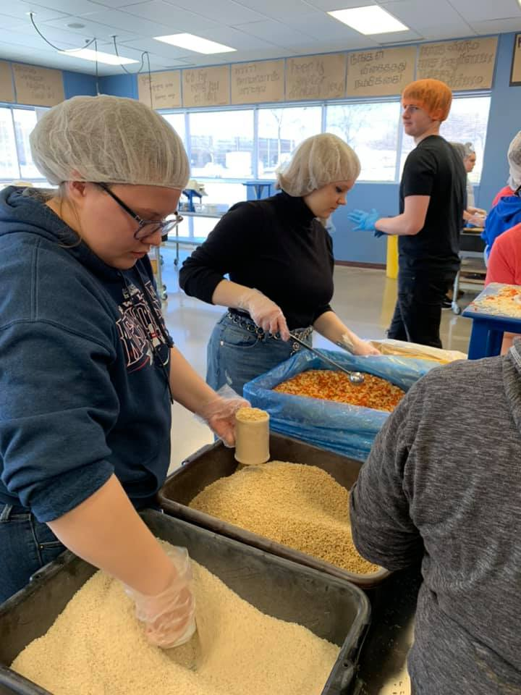
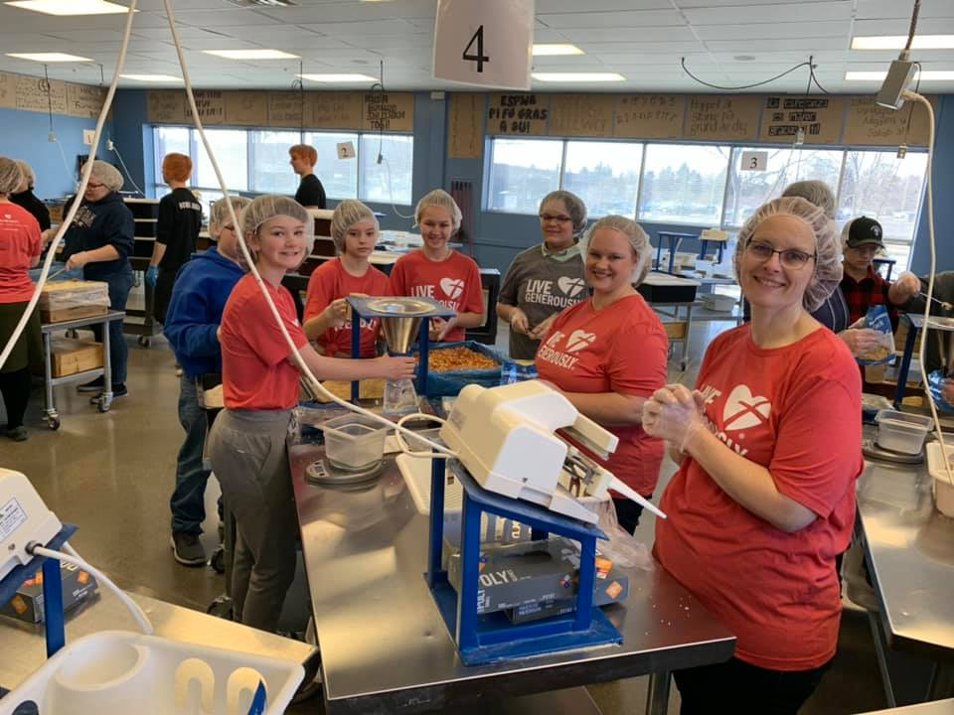
Notes:
Cover: Christ and the Samaritan Woman by Marcello Venusti. Copyright © The Art Archive/Superstock. Used by permission.

Slide 13
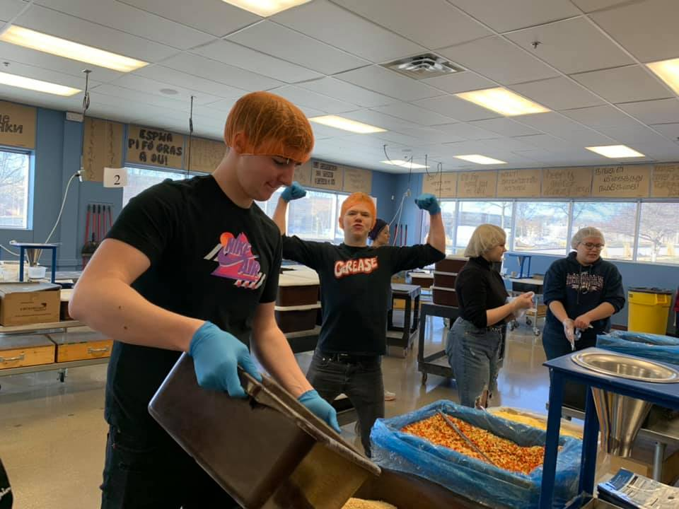
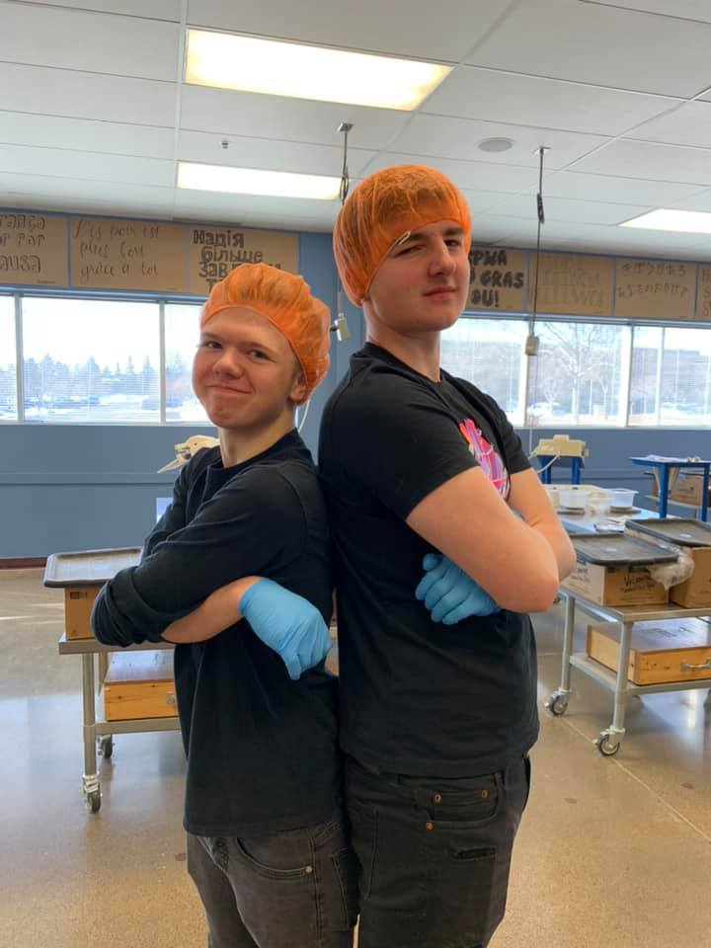
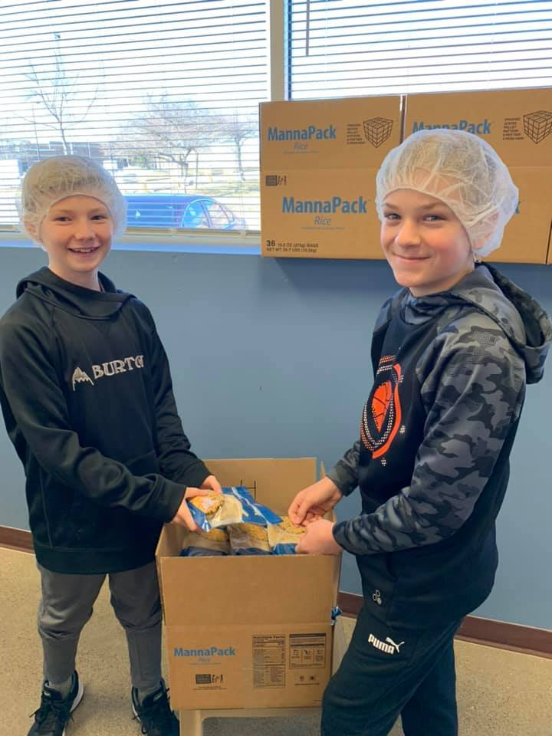
Notes:
Cover: Christ and the Samaritan Woman by Marcello Venusti. Copyright © The Art Archive/Superstock. Used by permission.

Slide 14
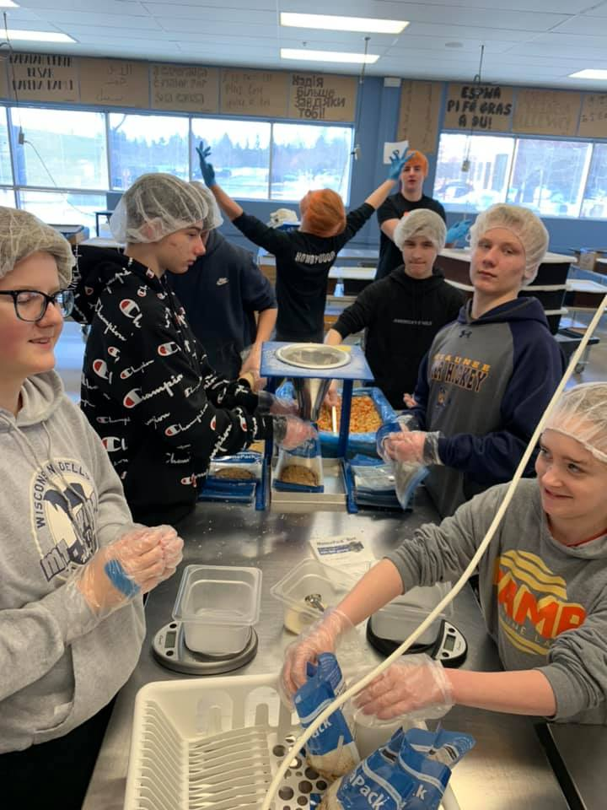
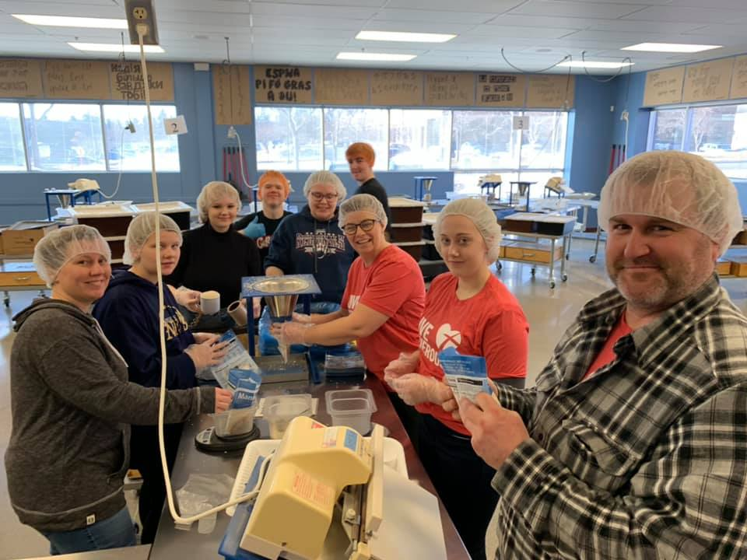
Notes:
Cover: Christ and the Samaritan Woman by Marcello Venusti. Copyright © The Art Archive/Superstock. Used by permission.

Slide 15
Feed My Starving Children staff were so grateful for our group’s packing. The next group of 160 people cancelled due to coronavirus precautions. There is great concern about the distribution of food to the poorest in our world, especially during this time of pandemic. May God provide.
Notes:
Cover: Christ and the Samaritan Woman by Marcello Venusti. Copyright © The Art Archive/Superstock. Used by permission.

